Slide 1

NALCAP Spain
North American Language and Culture Assistants Program
2022-23

Slide 2


Slide 3

About The Program
NALCAP is an educational outreach initiative of the Ministry of Education of Spain offering American college students and graduates the opportunity to be teaching assistants in Spain in classrooms across the country.
Participants in the program assist lead teachers in the teaching of the English language and the culture of the US and Canada while immersed in the language and culture of Spain, promoting a cultural link between the citizens of these countries.
The skills acquired through this experience will leave a deep international impact on the returning language assistant, to be put to use whether it be in the field of teaching, business or any other, as well as personal growth and development.

Slide 4

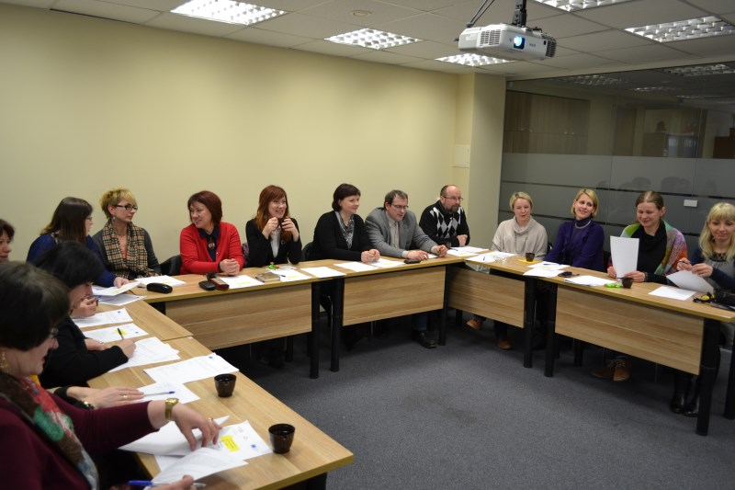
What will you be doing?
You will be a teacher’s assistant under the guidance and supervision of lead teachers in the English as a World/Foreign Language program at that school.
In other schools, you may be involved in being a TA in other school subjects taught in English such as social studies, science, tech, art or PE, if the school is part of a bilingual program. It’ll all depend on the school.
Your tasks will include:
  Conducting conversation lessons
  Presenting cultural presentations
  Attending department meetings
And may also be involved in EXTRA-CURRICULAR activities.
School plays
Workshops
Cultural activities
Field trips
Sports events
Musical performances

Slide 5

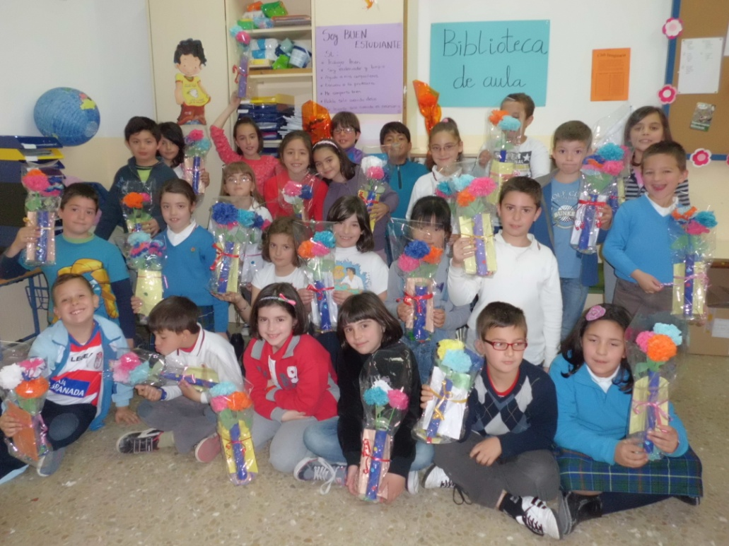
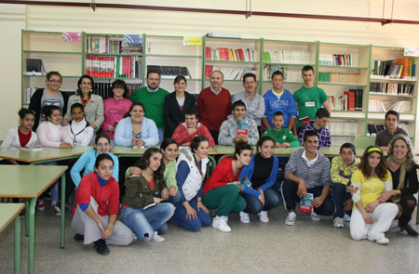
School placement types
Elementary schools (Including early childhood programs)
Secondary Schools
Language Schools
…in Spain

Slide 6

Program Requirements
  Be a U.S. citizen and have a valid U.S. passport
  Be a native-like speaker of English
Be a college sophomore, junior or senior or
Be a college graduate or
Have an associate degree or
Be a community college student in their last semester
Be in good physical and mental health
Have a clean background check
Aged 18-60
Having a basic level of Spanish is recommended for your personal daily life in Spain.

Slide 7




Program Conditions
Schedule: Between 12 and 16 class periods a week. Usually given a 3-day weekend.
You will receive a monthly stipend of about 700 - 1000€ depending on the region of Spain that you are assigned. This is a living wage.
Length of the program: 8 months October 1 – May 31/ June 30 in Madrid
Basic medical insurance
You must find housing on your own
An orientation course at the beginning of the school year
An official certificate upon the completion of the program
Paid school vacations. For example, a really long Christmas and Easter break
Option to renew for a second year with a positive evaluation from the school

Slide 8
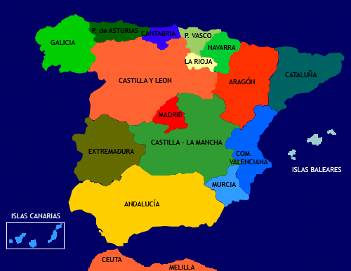
Regions of Spain
Applicants will have to select three preferred regional destinations in Spain. So, it’s a good idea to do your research!

Slide 9














Why Spain?

Slide 10

Apps open
February 1 to April 7, 2022
There are NO application FEES. It’s FREE.

Slide 11
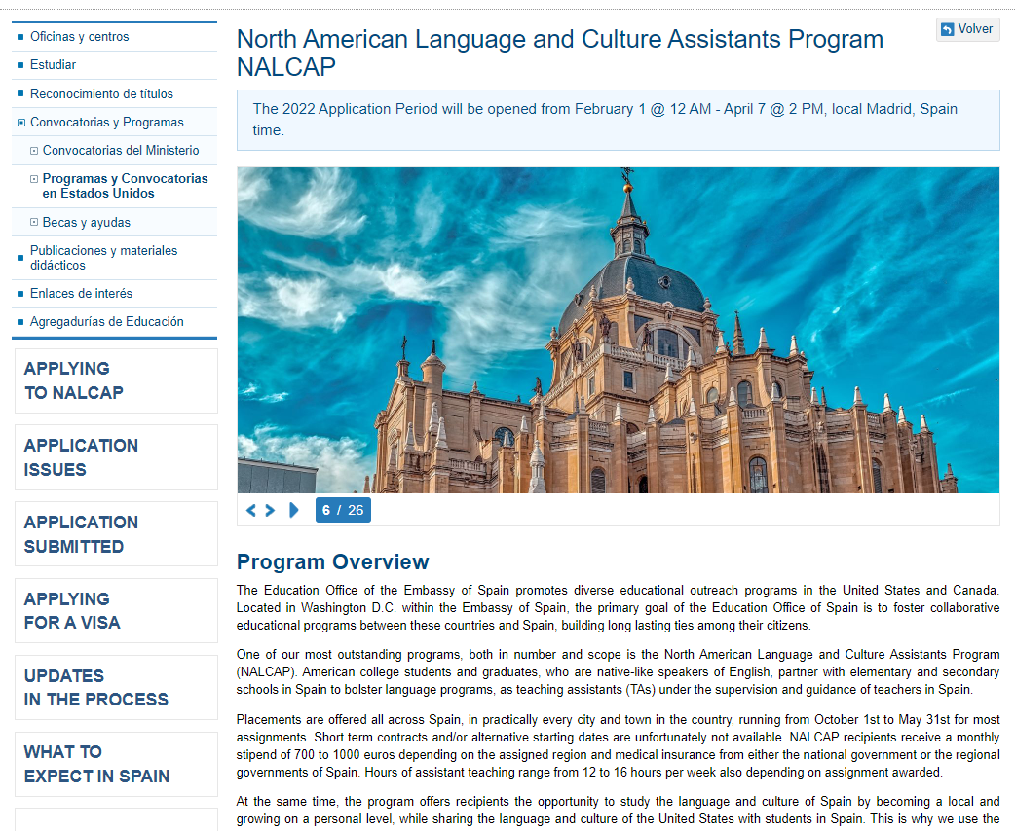
The NALCAP website

Slide 12

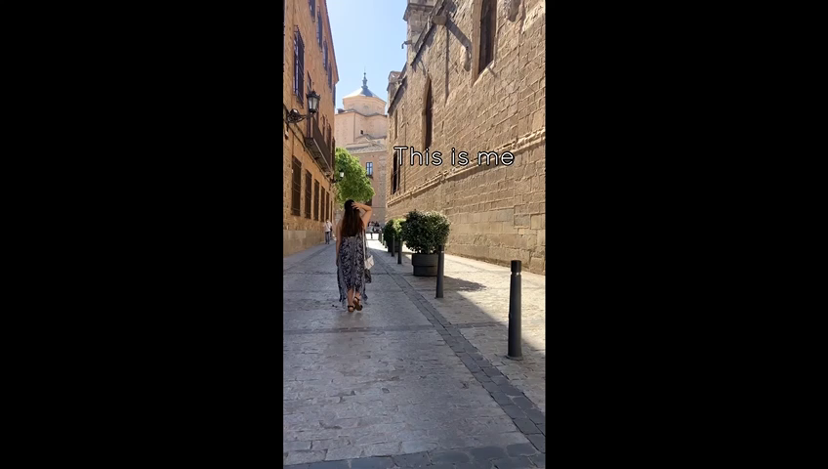
A NALCAP Experience:
A year in the life of a NALCAP Language Assistant

Slide 13





There’s nothing else quite like Spain

Slide 14


Interested in applying?
Please visit our website for complete info!
Just search for
NALCAP SPAIN
Disclaimer: The program is taking place this year in Spain in the context of Covid-19. All schools in the country are open and are taking the necessary measures to ensure that everyone is safe.

